Slide 1
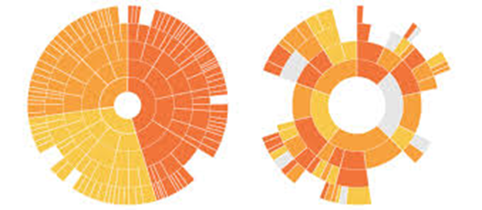
SUNBURST CHARTS

Slide 2
What is Sunburst charts
A sunburst diagram displays a hierarchical structure.
The origin of the organization is represented by the center of the circle, and each level of the organization by an aditional ring.
The last level (leaves) are located at the extreme outer part of the circle. It is very similar to a treemap, except it uses a radial layout.

Slide 3
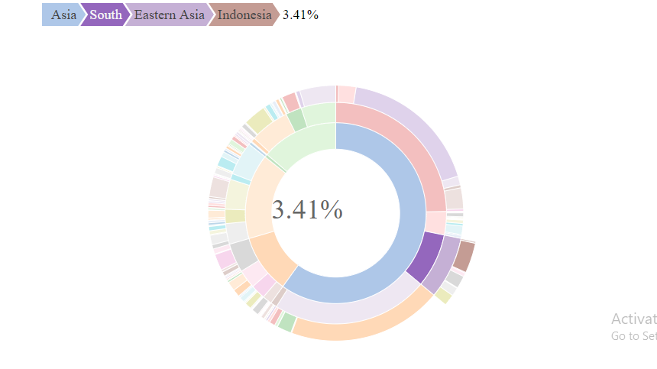
Where Sunburst chats can be used

Slide 4
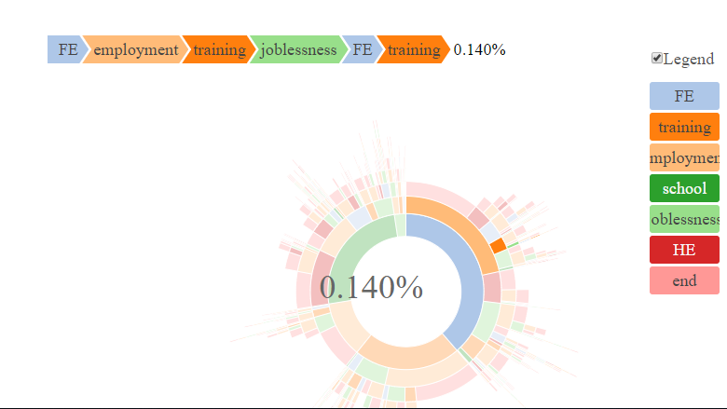
Contd.

Slide 5
Downsides
Labels - It is very hard to represent labels on sunburst charts. This is why using interactivity as above is often necessary to make the chart useful. This is an important downside though: it is hard to understand the figure in a glimpse.
Angles are hard to read - sunburst suffers the same issue than pie or donut chart. The human eye is bad at reading angles. As a consequence, it is hard to deduce values behind items accurately.

Slide 6
References
https://www.data-to-viz.com/graph/sunburst.html

